Slide 1
Computational Thinking, Problem Solving, and Programming
TOPIC 4.0 – Computational thinking
TOPIC 4
4.3.9: Algorithm Design

Slide 2

REVIEW REVIEW REVIEW REVIEW REVIEW REVIEW
THE WARM-UP QUESTION
Write a procedure that takes a grade as input, and prints out what letter that grade corresponds to.
>= 90 = A
>= 80 and < 90 = B
>= 70 and < 80 = C
>= 60 and < 70 = D
> 60 = F

Slide 3
REVIEW REVIEW REVIEW REVIEW REVIEW REVIEW
THE WARM-UP ANSWER
def calculateGrade(grade):
if grade >= 90:
print (“A”)
elif grade >= 80 and grade < 90:
print (“B”)
elif grade >= 70 and grade < 80:
print (“C”)
elif grade >= 60 and grade < 70:
print(“D”)
else:
print(“F”)
//Assume variable GRADE already exists
if GRADE >= 90 then
output A
else if GRADE >= 80 and GRADE < 90 then
output B
else if GRADE >= 70 and GRADE < 80 then
output C
else if GRADE >= 60 and GRADE < 70 then
output D
else
output F
end if

Slide 4
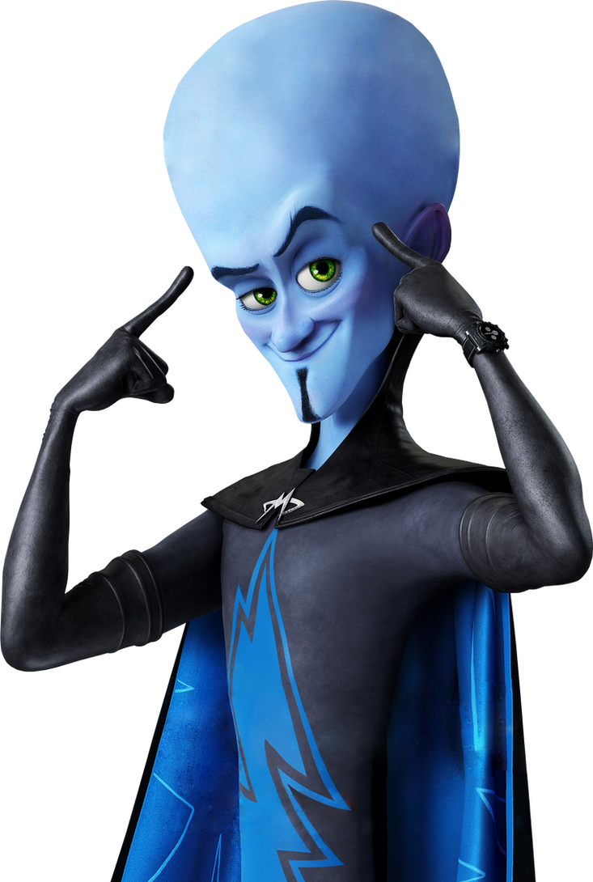
TOPIC 4.3.9 – INTRO TO PROGRAMMING
PREPARE FOR THE GAUNTLET
Today, we’ll be working through a rapid-fire set of programming problems in Python
We’ll test and build your knowledge of selection statements, loops, and procedures
You will look like this guy when you’re done
(hopefully not blue tho)

Slide 5


CHALLENGE 1
To start, let’s take it slow.
Write a program that takes in an input value of a car speed, and an input value of a speed limit.
If the car speed is greater than the speed limit, print out (“Slow down! You’re going <however many miles> above the speed limit”) and subtract one from the speed. It should keep printing until the car has slowed down to the speed limit.
ROUND ONE

Slide 6
CHALLENGE 2
Create a program that lets the use type in as many positive numbers as they’d like
Once they type a negative number, stop asking them for numbers, and find out what the largest number they typed in was.
Print the largest number to the screen
ROUND TWO

Slide 7
CHALLENGE 3
A company decides to give a bonus to employees based on the following criteria
If they’ve worked there for 10 years, 10% bonus,
If >= 6 and < 10, 8% bonus
If less than 6, 5% bonus
Ask the user for their salary and years of work and calculate their bonus, and print it to the screen.
ROUND THREE

Slide 8
CHALLENGE 4
Create a program that will take in a year and print out whether or not that year is a leap year.
Leap years are every four years, unless that year is divisible by 100, but still happen if that year is divisible by 400
Print out true or false based on if the year would be a leap year
ROUND FOUR

Slide 9
CHALLENGE 5
Create a program that will accept three sides of a triangle, and return if it is an equilateral, isosceles, or scalene triangle
FINAL ROUND!

Slide 10
TOPIC 4.3.9 – INTRO TO PROGRAMMING
CONGRATULATIONS FIGHTERS
You’ve all done good work! Give yourself a pat on the back

Slide 11

TOPIC 4.2.1 – THINKING Logically
Vocab to remember
Variable
Constant
Scope
Local Variable
Global Variable
Mod
High Level Language

